Slide 1
Quality Circle Forum of India
presents
Problem Solving Techniques
- a simplified revised practical guide

Slide 2


Slide 3
What is a Pareto diagram?
Pareto diagram is a technique of arranging data according to priority or importance and using into a problem solving framework.
This helps to find out the ‘VITAL FEW’ from the ‘USEFUL MANY’ for problem selection.
100
80
60
40
20
0
800
700
600
500
No of complaints
%
400
300
200
100
0
Types of defects

Slide 4
It is often said that one who makes noise always gets the attention

Slide 5
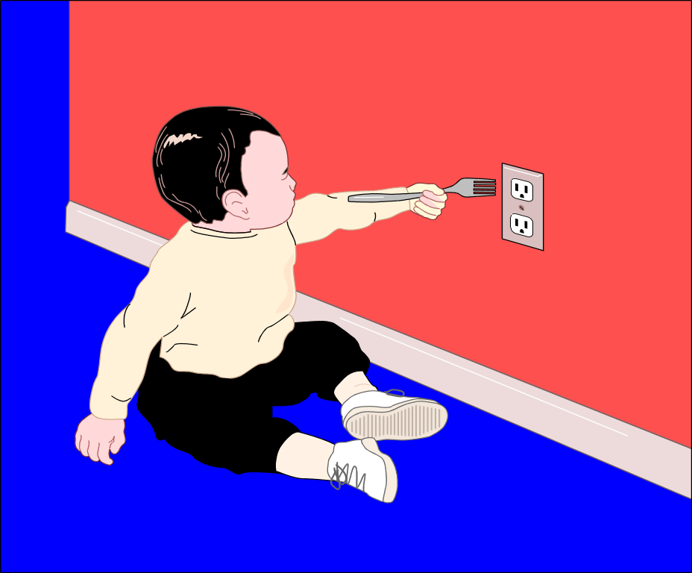
This is the fact of life. By this the most important aspect gets neglected.

Slide 6

When it comes to problem solving, we cannot go by this perception but have to rely upon data & facts.

Slide 7

As said earlier Pareto Analysis or Pareto Diagram
is a technique of arranging
data according to priority or
importance and using
it into a problem solving
frame work.

Slide 8

This helps to find out the
"VITAL FEW"
from the
"USEFUL MANY"
for problem selection

Slide 9

I failed in my exams, I could not get into the college tennis team, Mom is annoyed with me, I am overweight. God, life could not get any worse. All this happened because of my LAZINESS.
We can observe that most of our problems arise from a few of the sources.

Slide 10
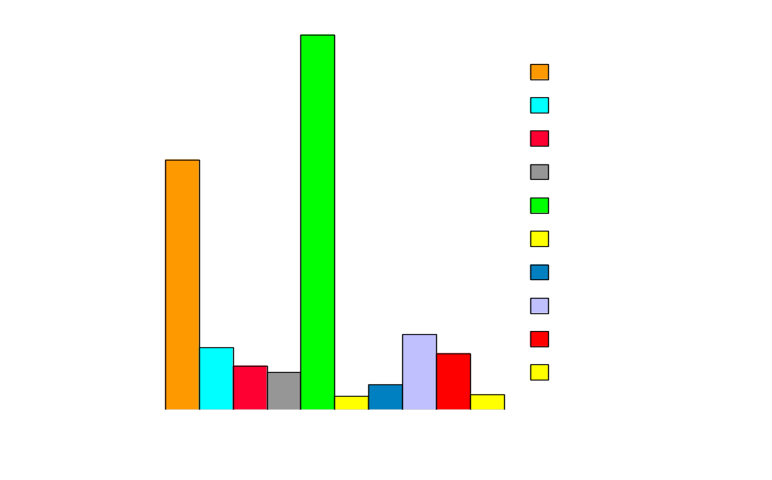
Sale of Visual Graphics Adapter (VGA) cards by TRIDENT Ltd.. to various Indian Computer companies during 1991-92.
No
Companies
For example only two companies (20%) account for sale of 5,00,000 cards (80%)

Slide 11
Sales of SUPERBYTE COMPUTER store
for the year 1994-1995 (In million)
1000
900
800
Monitors
700
Diskettes
600
VGA cards
Sales
500
HDD
400
Multimedia Kits
300
Computers
200
Printers
100
0
Item
Only one company (1 out of 7 ie. 14%) accounts for 10 million out of 16 million ( 62%)

Slide 12

It is few children in a class who cause maximum nuisance

Slide 13
The italian economist Vilfredo Pareto (1848-1923) during his study of distribution of wealth in his country observed that 80% to 90% of the Italy’s wealth lay in the hands of 10% to 20% of the population.

Slide 14

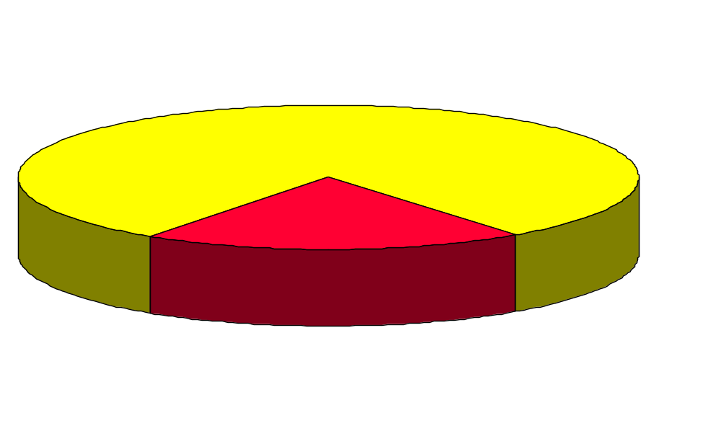
Study of wealth distribution by Italian economist Vilfredo Pareto (1848 - 1923) in his country.
Italy’s Wealth
Owned by 20% of the population
80 % of wealth
20% of wealth
Owned by 80% of the population

Slide 15
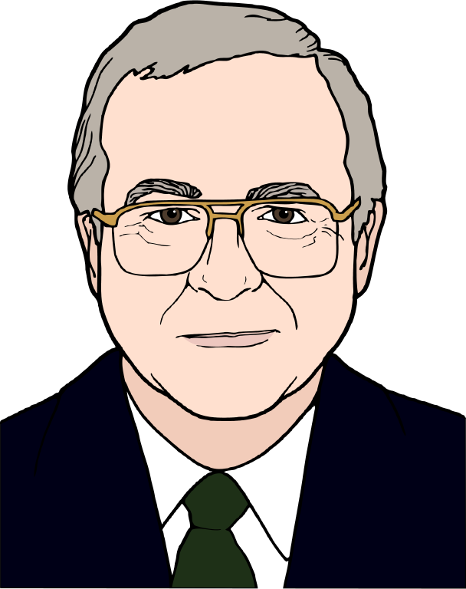
The U.S Economist M .G.Lorenz presented this distribution in a theoretical curve in 1907. This curve is called Lorenz’s curve of concentration.

Slide 16
However it was Dr. J . M . Juran in mid 1920s who observed that the quality defects are unequal in frequency i.e. few defects accounted for bulk of the rejections or defectives.

Slide 17

Ha!! This is interesting. A few defects account for majority of the defectives
800
Defective
700
Product
600
Insufficient
No
quantity
500
Incorrect
400
Shipment
300
Damaged
200
Product
100
Delayed
0
delivery
Nature of complaint
Dr. Juran

Slide 18

GENERAL MOTORS
He learnt further on this phenomenon while working as a consultant for General Motors in 1930.

Slide 19

Just have a look at the salaries of the executives Dr. Juran
Mr.Merk Hale showed Dr.J.M.Juran how executive salary in GM's are in line with Pareto's theory.

Slide 20

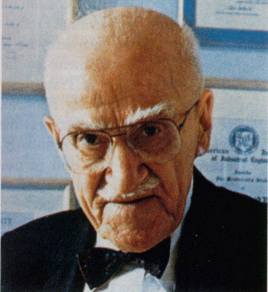
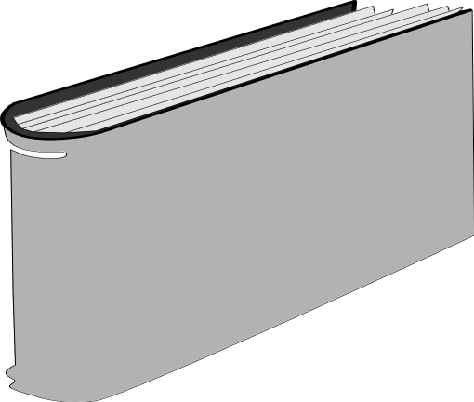
After further research in 1940’s, he observed the unequal distribution (Mal distribution) of quality losses and listed a variety of such cases in his Quality Control Handbook.

Slide 21
A number of persons over the centuries
observed this phenomenon of
vital few and useful many (earlier known as vital few and trivial many).

Slide 22
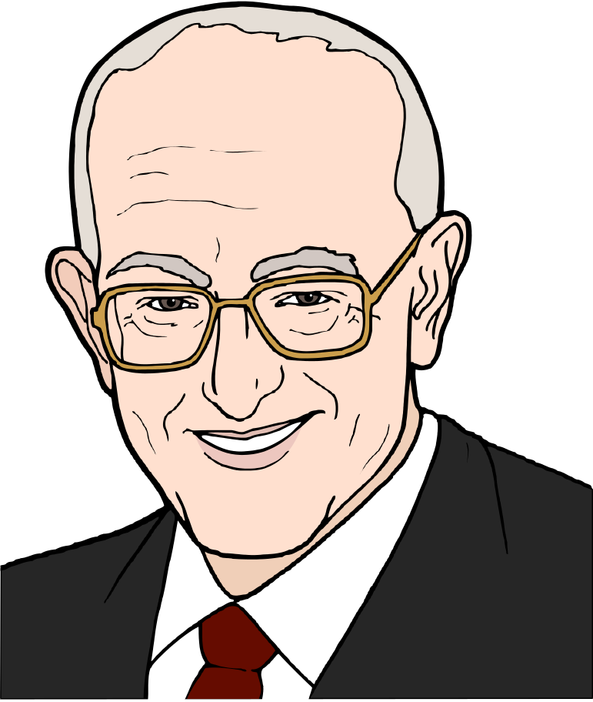
To sum up Pareto observed this phenomenon as applied to wealth distribution and advanced the theory of a logarithmic law of income distribution to model the phenomenon.

Slide 23
Lorenz Curve
M.C.Lorenz developed a form of cumulative curve to depict the distribution of wealth.

Slide 24
Juran was the first to identify the phenomenon of 'the vital few useful many,' as a 'universal' principle applicable to many fields.

Slide 25
Lorenz Curve
100
90
80
70
60
50
40
30
20
10
0
150
140
136
130
126
F
120
114
G
110
100
100
A
90
85
Quantity (Nos)
%
B
80
70
65
C
E
60
50
D
40
H
30
20
10
0
Defects
Juran applied the name 'Pareto Principle' to this universal Phenomenon of “vital few, Useful many” and applied the Lorenz curve to depict this in universal graph form.

Slide 26

Two types of
pareto analysis
are available
to identify areas
which should receive
priority attention.

Slide 27
One is based on phenomenon

Slide 28
Another by causes

Slide 29

Pareto Diagram based on phenomenon
Quality : Defects, faults, failures, complaints, return items, repairs etc.
Complaints on products sold in the Television shopping Network during the month of November 1994
100
80
60
40
20
0
800
Defective
700
Product
600
Insufficient
quantity
No
500
%
Incorrect
400
Shipment
300
Damaged
200
Product
100
Delayed
0
delivery
Nature of Complaint

Slide 30

Pareto Diagram based on phenomenon
Cost: Amount of tax, expenses etc.
Household expenses of Mr. Pendse during the year 1995
100
80
60
40
20
0
120000
House rent
100000
Food
80000
Taxes
Rs
%
Clothes
60000
Medical
40000
Travel
Sundries
20000
0
Items

Slide 31

Pareto Diagram based on phenomenon
Delivery : Stock, shortages, defaults in payments, delays in delivery.
Delays in delivery by Pizza Hut during the
month of March 1996 shift wise
100
80
60
40
20
0
140
120
100
5PM-8PM
8PM-11PM
80
%
No of delayed deliveries
11AM-2PM
60
2PM-5PM
40
8AM-11AM
20
0
Shift

Slide 32
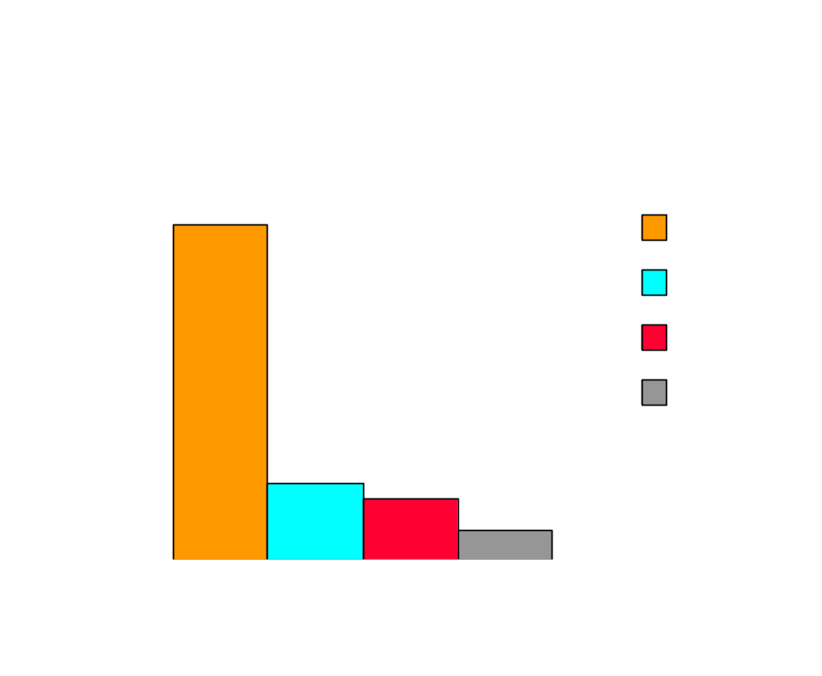
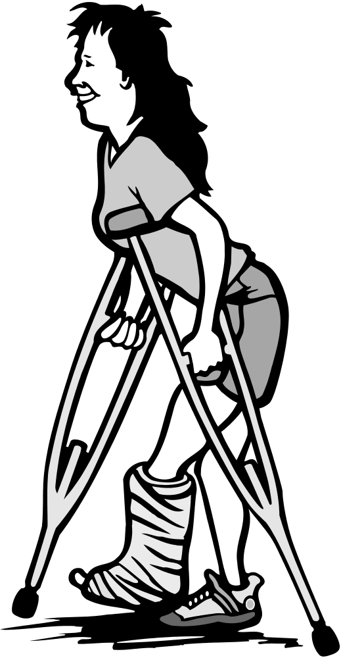
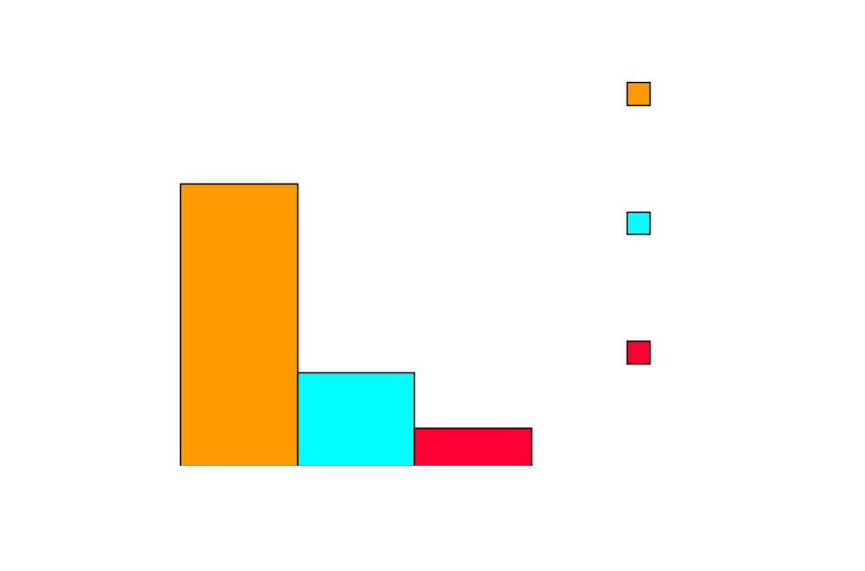
Pareto Diagram based on phenomenon
Safety : Accidents, mistakes, breakdowns etc.
100
50
0
%
No
Causes for finger injury accidents
100
50
0
%
Accidents in Mumbai During the 2nd week of Jan 1996 resulting in physical injuries.
No

Slide 33

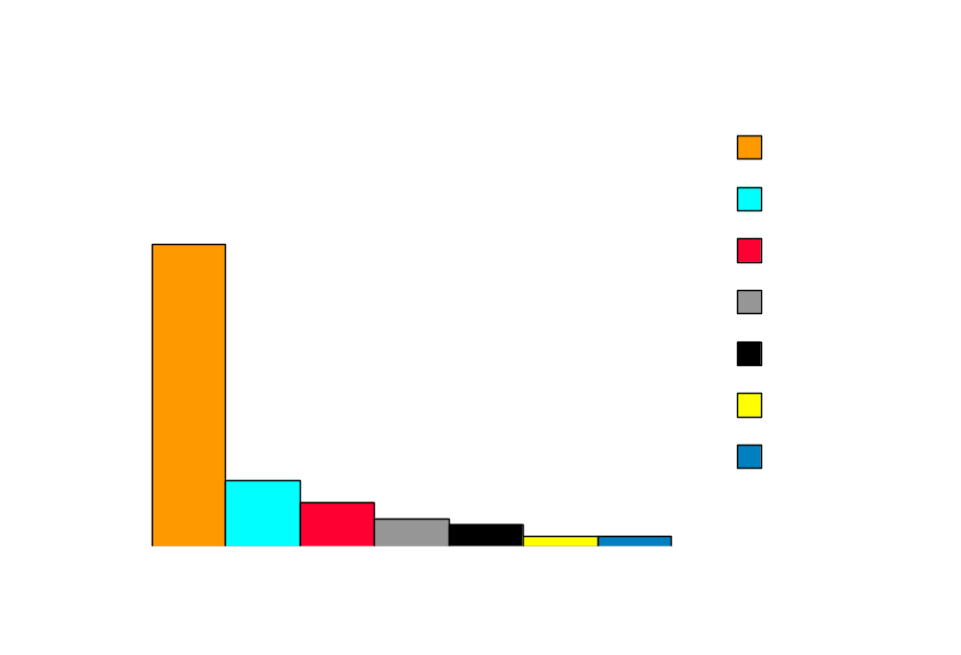
Pareto Diagram based on causes
Operator : Shift, group, age, experience, skill, individual person etc.
BALAJI MACHINE TOOLS LTD.
Defective Materials produced by the morning shift (segregated worker wise)
100
80
60
40
20
0
%
No
Worker

Slide 34
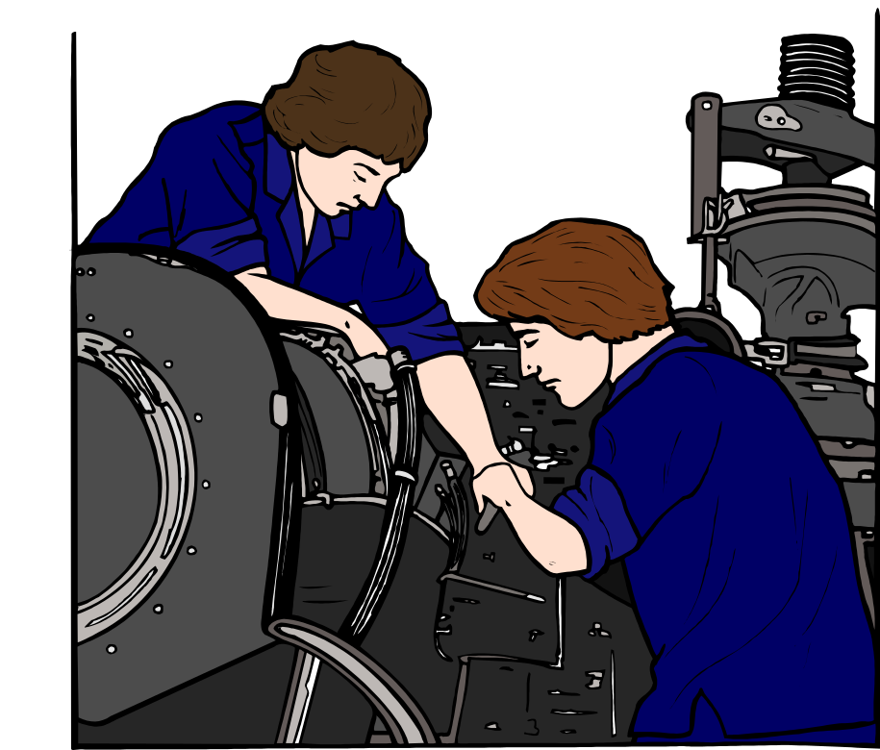
Pareto Diagram based on causes
Machine : Machines, equipments, tools, modes, instruments etc.
BALAJI MACHINE TOOLS LTD.
Defective Materials produced by the night shift (segregated machine wise)
100
80
60
40
20
0
90
%
80
70
Machine F
Machine E
60
Machine C
No
50
Machine B
40
Machine A
30
Machine D
20
Machine G
10
0
Machine

Slide 35
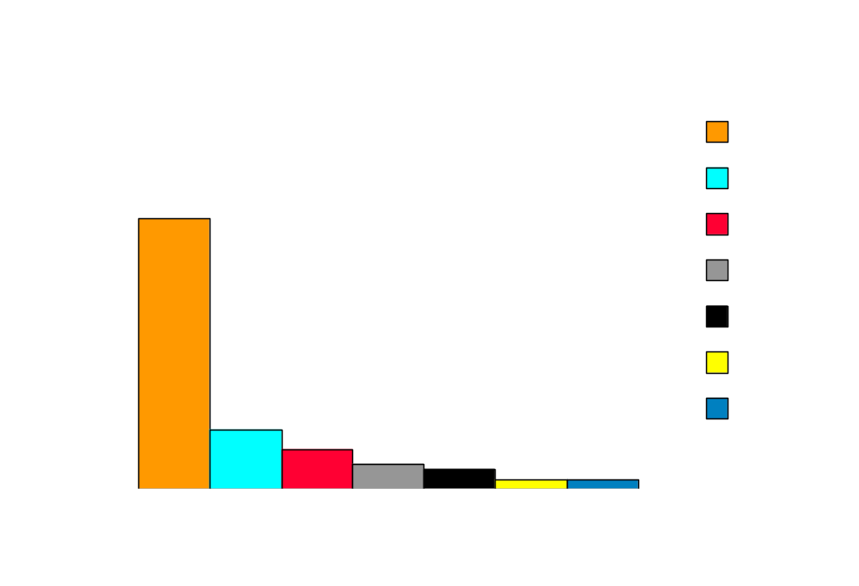
Pareto Diagram based on causes
Raw Material : Manufacturer, plant, lot, type etc.
BALAJI MACHINE TOOLS LTD.
Defective Materials produced by the night shift
(segregated Raw material lot wise)
100
80
60
40
20
0
%
No
Raw material Lot

Slide 36

Pareto Diagram based on causes
Operation Method : Conditions, order, arrangements, methods etc.
Hours spent by warehouse workers on different jobs
100
80
60
40
20
0
Receival
1800
1600
Dispatching
1400
Inspecting
1200
1000
%
Tending
HOURS
warehouse
800
Status reports
600
400
Inventory
taking
200
Dead stock
0
disposal
Type of Job

Slide 37
BALAJI MACHINE TOOLS LTD.
Frequency of machine breakdown 1991-92 (segregated machine wise)
100
80
60
40
20
0
90
80
Machine F
70
Machine E
60
Machine C
No
50
Machine B
40
%
Machine A
30
Machine D
20
Machine G
10
0
Machine
They can also be divided on the basis of
a) Frequency of each cause/source

Slide 38
BALAJI MACHINE TOOLS LTD.
Frequency of machine breakdown 1991-92 (segregated machine wise)
100
80
60
40
20
0
90
80
70
Machine F
Machine E
60
Machine C
No
50
%
Machine B
40
Machine A
30
Machine D
20
Machine G
10
0
Machine
They can also be divided on the basis of
a) Frequency of each cause/source

Slide 39

100
80
60
40
20
0
24
%
20
Raw Material
16
Labour
12
Machine
Sales
8
Distribution
4
0
b) based on cost

Slide 40
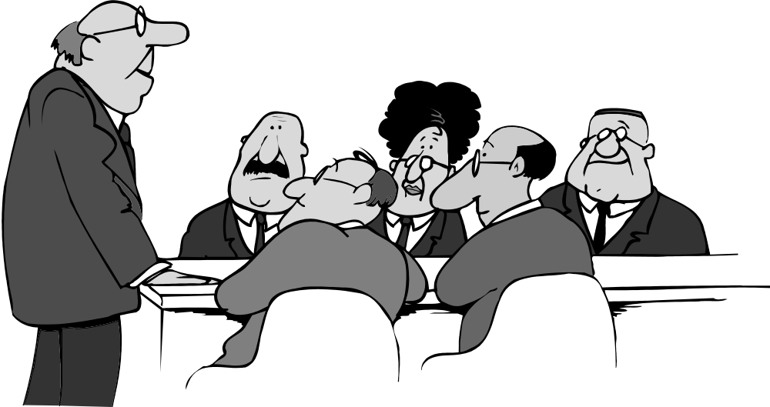
ELECTRIC SHOCK SAFETY EDUCATION
The identification of the most frequently occurring source or reason is necessary for instituting appropriate counter measures.

Slide 41

The analysis using cost as the basis is necessary to derive maximum financial benefit from the effort expended.

Slide 42
Hours spent by warehouse workers on different jobs
100
80
60
40
20
0
Receival
1800
1600
Dispatching
1400
Inspecting
1200
HOURS
%
Tending
1000
Vital Few
warehouse
800
Status reports
600
400
Inventory
taking
200
Dead stock
0
disposal
Type of Job
Pareto diagrams and Pareto tables are presentation techniques. They are used to show facts and they help us to separate the "vital few".

Slide 43
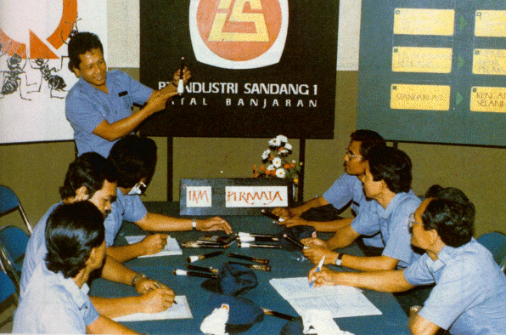
Using pareto analysis, Quality Circles will find it easier in selection of problem

Slide 44
Hours spent by warehouse workers on different jobs
100
80
60
40
20
0
Receival
Dispatching
Inspecting
Level of each factor
Hours
%
Tending
warehouse
Status reports
Inventory
taking
Dead stock
disposal
Type of Job
Pareto diagrams and table include three basic elements. All factors which are responsible for the total effect are arranged in a descending order. This gives a clarity regarding the level of contribution of each factor.

Slide 45
Cumulative hours spent by warehouse workers on different jobs
100
80
60
40
20
0
1800
Receival
1600
Dispatching
1400
1200
Inspecting
1000
Tending
HOURS
800
warehouse
600
Status reports
%
400
Inventory
200
taking
Dead stock
0
disposal
Type of Job
The levels of contribution of each factor is expressed numerically (in quantity as well as percentage)

Slide 46
Cumulative hours spent by warehouse workers on different jobs
100
80
60
40
20
0
1800
Receival
1600
Dispatching
1400
1200
Inspecting
1000
Tending
HOURS
800
warehouse
600
Status reports
%
400
Inventory
200
taking
Dead stock
0
disposal
Type of Job
The cumulative curve shows the total of the ranked contributors

Slide 47
Let us find out how to make a pareto diagram with the help of an example

Slide 48
A ceiling fan manufacturing industry wants to improve its quality by reducing the number of defective items. Out of 1000 fans inspected in one week a total of 150 were found defective. The inspection report is as follows.

Slide 49
EXAMPLE
TYPE OF DEFECT NUMBER OF ITEMS
A. Motor winding 20
B. Bend in Blades 15
C. Cracks on central rod 14
D. Capacitor 10
E. Scratches 12
F. Regulator 40
G. Bend in screws 25
H. Others 14
Total 150

Slide 50
90
80
70
60
50
40
30
20
10
0
In order to make a Pareto diagram the data have to be rearranged according to the order of importance i.e. factor or defect which contributed to the maximum problem

Slide 51
Here it is Regulator 40 Nos, followed by next highest i.e.
Bend in screws 25 Nos. In this way arrange all the data except for 'others' which is cumulative of so many defects but individually lower.

Slide 52
To make a Pareto diagram rearranged data table
TYPE OF DEFECT NUMBER OF DEFECTS
F. Regulator 40
G. Bend in screws 25
A. Motor winding 20
B. Bend in Blades 15
C. Cracks on central rod 14
E. Scratches 12
D. Capacitor 10
H. Others 14
Total 150

Slide 53
Next step is to calculate "percentage of each to total" and "cumulative figures of percentage " for each type of defect.

Slide 54
The percentage of "Regulator" defect to total
= (40/150) X 100 = 27%

Slide 55
And the percentage of "Bend In Screws” defect to total
= (25/150) X 100 = 17%

Slide 56
Similarly, calculate the percentages for all other types of defects.

Slide 57
Now arrange them in a table showing.
a) Type of defect
b) Number or quantum of defect.
c) Cumulative
d) Percentage of defect to total
e) Cumulative percentage

Slide 58
TYPE NUMBER CUM % OF CUM
OF OF TOTAL %
DEFECT FANS
F. Regulator 40 40 27% 27%
G. Bend in Screws 25 65 17% 44%
A. Motor winding 20 85 13% 57%
B. Bend in wings 15 100 10% 67%
C. Cracks in Central rod 14 114 9% 76%
E. Scratches 12 126 8% 84%
D. Capacitor 10 136 7% 91%
H. Others 14 150 9% 100%
Total 150 100%

Slide 59
150
100
90
80
70
60
50
40
30
20
10
0
140
130
120
110
100
Quantity (Nos)
90
80
%
70
60
50
40
30
20
10
0
Now let us make the Pareto Graph. Draw a vertical axis on both sides and mark number on left and % on right. Draw horizontal axis and divide it into No. of intervals equivalent to types of defects

Slide 60
100
90
80
70
60
50
40
30
20
10
0
150
140
130
120
110
100
90
Quantity (Nos)
80
70
%
60
50
40
30
20
10
0
Construct a Bar Diagram to represent the data as per tally sheet

Slide 61
150
100
90
80
70
60
50
40
30
20
10
0
140
136
130
126
120
114
110
100
100
90
85
Quantity (Nos)
%
80
70
65
60
50
40
30
20
10
0
Draw cumulative curve (Pareto Curve). Mark the cumulative value (or percentage) and connect the points by a line.

Slide 62
150
100
90
80
70
60
50
40
30
20
10
0
140
136
130
126
F
120
114
G
110
100
100
A
85
Quantity (Nos)
90
B
80
%
70
65
C
E
60
50
D
40
H
30
20
10
0
Defects
Write all the necessary information concerning the diagram.

Slide 63
150
100
90
80
70
60
50
40
30
20
10
0
140
136
130
126
F
120
114
G
110
100
100
A
85
Quantity (Nos)
90
B
80
%
70
65
C
E
60
50
D
40
H
30
20
10
0
Defects
As you can see now Pareto Diagram is a good tool for selection of a problem.

Slide 64

This is made based on data and should help in decision making i.e. which problem we should tackle first. Here decision is based on facts and not on personal preferences.
100
80
60
40
20
0
90
80
70
Worker F
60
%
Worker E
50
Worker C
40
Worker B
30
Worker A
20
Worker D
10
Worker G
0

Slide 65
150
100
90
80
70
60
50
40
30
20
10
0
140
130
F
120
76 %
G
110
100
67 %
Quantity (Nos)
57 %
A
90
%
B
80
C
70
60
E
50
D
40
H
30
20
10
0
Defects
In this case first three defects contribute to 57% of the problem and with the fourth one 67%. We should tackle them for effective result. The defect “cracks in central rod” has safety implications and hence to be included in the vital few making 1 to 5 constituting 76%

Slide 66

PRINCIPLE FOLLOWED FOR SELECTION
Let us concentrate on the first two workers. They constitute more than 60% of the defective parts.
100
80
60
40
20
0
90
80
70
Worker F
60
%
Worker E
50
Worker C
40
Worker B
30
Worker A
Worker D
20
Worker G
10
0
Identify few contributors from the diagram which account for about 60% of the total.

Slide 67

We have chosen Worker’s E & F as the vital few. Let us brainstorm to gather useful suggestions so as to impart meaningful training to them.
Represent these as 'Vital Few' and proceed towards solving these problems

Slide 68

The performance of E & F seems to have improved considerably. I think we should collect fresh data on the present situation
Once they are solved or satisfactorily attended to, collect data on present situation on the defect status.

Slide 69
Now we should concentrate on Worker C and the rest
100
80
60
40
20
0
24
20
16
Worker C
Worker B
12
%
Worker A
Worker D
8
Worker G
4
0
The present position maybe, that those defects which were not in priority earlier are now occupying prime position and hence to be taken up for solving .

Slide 70
Work on the same line as earlier and carry on till you are totally satisfied in your effort to eliminate the problem.

Slide 71
Cumulative hours spent by warehouse workers on different jobs
100
80
60
40
20
0
Receival
1800
1600
Dispatching
1400
Inspecting
1200
1000
Tending
warehouse
800
%
Status reports
HOURS
600
400
Inventory
taking
200
Dead stock
0
disposal
Nature of job
In pareto diagram cumulative curve serves an important function. It helps you to find out the break-point i.e. up to what level you should pay attention

Slide 72
Cumulative hours spent by warehouse workers on different jobs
1800
Receival
100
80
60
40
20
0
1600
Dispatching
1400
Inspecting
1200
HOURS
Break point
1000
%
Tending
warehouse
800
Status reports
600
Inventory
400
taking
200
Dead stock
disposal
0
If you carefully study the cumulative graph, in most of them, there will be substantial change in the slope of the line graph showing the break point.

Slide 73

Where you do not find such a change, group should decide how many defect types should be taken up at a time depending upon their capabilities.

Slide 74
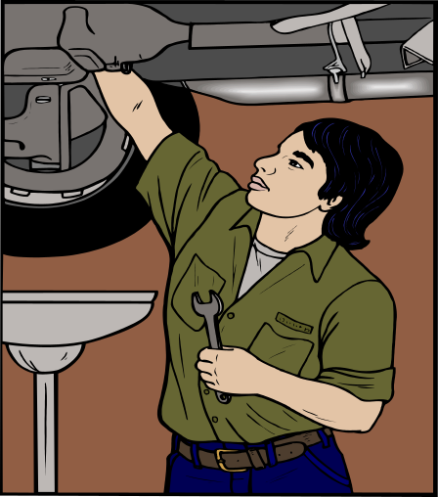
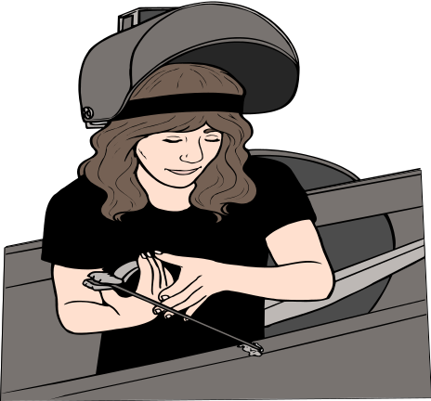
USES OF PARETO ANALYSIS
The uses are as follows
QUALITY CIRCLE
The most obvious and common use of Pareto Analysis is in prioritizing and defining problems.

Slide 75

100
80
60
40
20
0
90
80
70
Worker F
60
%
Worker E
50
Worker C
40
Worker B
Worker A
30
Worker D
20
Worker G
10
0
The Pareto principle and pareto analysis help the Quality Circle members to focus on those few vital problems which, when carefully addressed, will result in the maximum benefit to the organisation.

Slide 76

After the project is identified, it needs to be refined further to determine or analyse the symptoms.

Slide 77

Sir, problem is that the LOT F is --------------------------------------------
90
100
80
60
40
20
0
80
70
LOT F
60
LOT E
50
LOT C
40
%
LOT B
30
LOT A
LOT D
20
LOT G
10
0
Pareto analysis is also useful to identify the root causes of the quality problems

Slide 78
I think we should draw a pareto again to check up the performance of the remedy.
Pareto analysis is useful to check the effectiveness of the remedy on its implementation.

Slide 79
Defective parts manufactured worker-wise HMT Limited
100
80
60
40
20
0
100
80
60
40
20
0
90
90
80
80
70
70
Worker F
%
%
Worker E
60
60
Worker C
50
50
Worker C
Worker B
40
40
Worker B
Worker A
30
30
Worker A
Worker D
20
20
Worker D
Worker G
10
10
Worker G
0
0
BEFORE
AFTER
Pareto diagram before and after solving a problem.

Slide 80
Sometimes when you are on the problem solving process, one defect itself may need detailed analysis. In such a case you may draw a pareto diagram for that defect for diagnosis and for effectively tackling it.

Slide 81
PITFALLS
DEFECTIVE PARTS SUPPLIER WISE
ATLAS CYCLES LTD.
120
100
80
60
40
20
0
100
80
Supplier B
Supplier C
60
Supplier D
Supplier A
40
Supplier E
20
%
0
If all the bars or most of the bars are roughly the same height

Slide 82
MACHINE BREAKDOWN IN THE VARIOUS UNITS OF BHEL
DURING 1995
100
80
60
40
20
0
130
120
110
100
90
UNIT 6
80
UNIT 2
70
UNIT 3
60
UNIT 1
50
UNIT 4
40
UNIT 5
30
20
10
%
0
If more than 50% categories account for 60% of total defect.

Slide 83
Careful analysis shows that such a thing should not happen.
In case of such a situation go for further stratification.

Slide 84
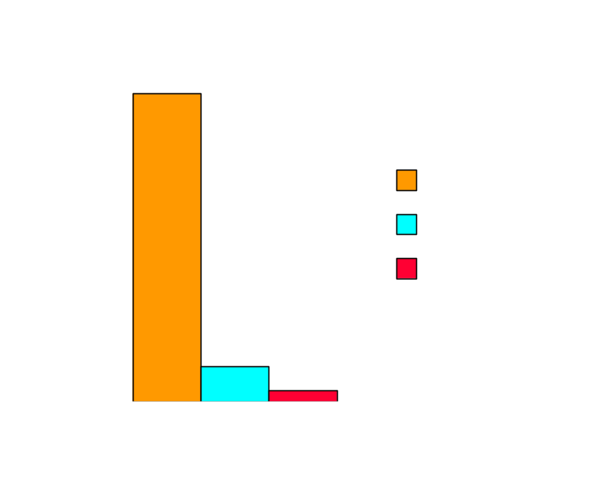
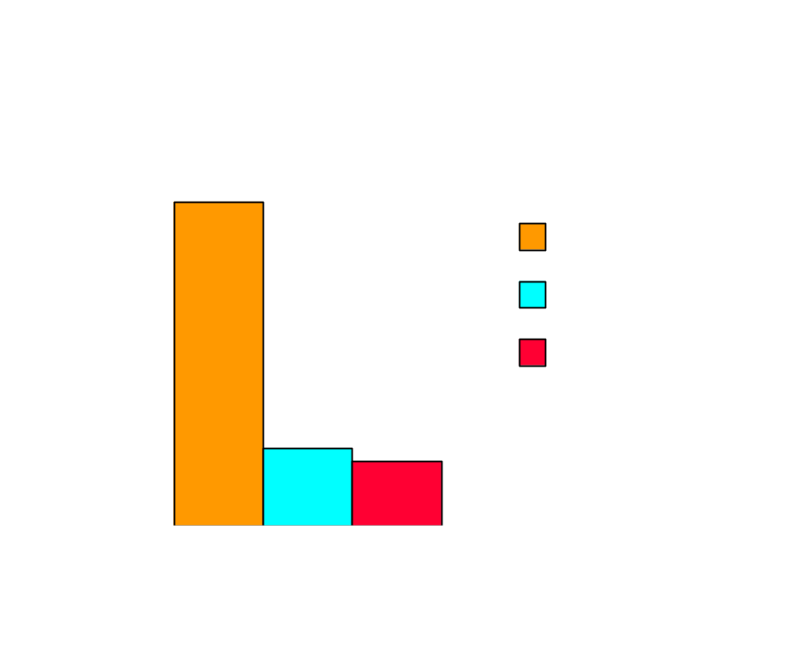
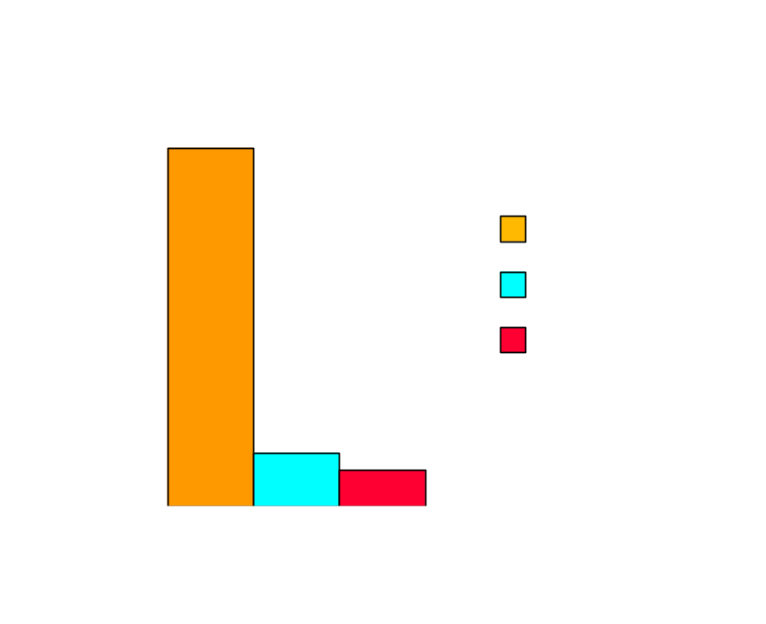
100
50
0
100
50
0
%
%
So let us stratify the machines in the first three units of the previous problem supplier wise.
100
50
0
UNIT 2
%
UNIT 1
UNIT 3

Slide 85
SUMMARY
With the help of pareto analysis we are able to present the data gathered in a lucid manner which helps us to select 'Vital few' areas. This way for a given effort we are able to get the maximum benefit.
In order to find out the 'Vital few' factors we may have to stratify the data available with us. Carry on the process of stratification till you have a clearer picture.

Slide 86
SUMMARY
Pareto diagram is a visual method for separating the 'Vital Few' from ' Useful Many.’
This helps us in establishing consensus regarding priorities based on facts. Therefore, it takes us quickly to the action stage.
Pareto also helps us to find out those items which are not profitable for us to worry about on an immediate basis. Sometimes such a mistaken notion, which we might get due to lack of information, would also be cleared.

Slide 87

Prepared by
G. Vijaykumar

Slide 88


